Slide 1
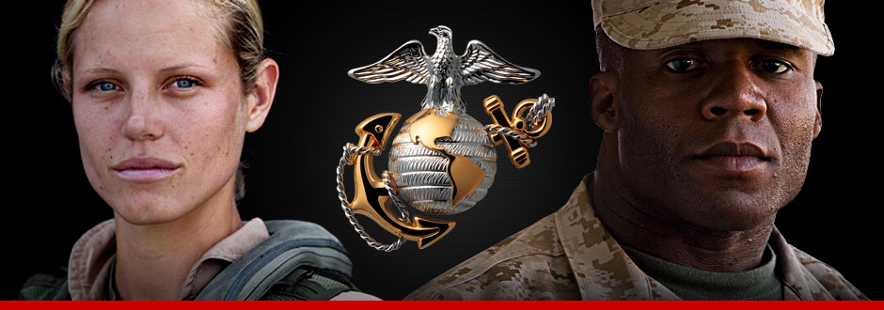
Substance Abuse Training for Supervisors

Slide 2
TEMPLATE ONLY
These slides are a template to support annual supervisory training per MCO 5300.17 and MARADMIN 499/15
This template is intended for unit-specific modification
Additional training resources are available via the MAPIT Dashboard which includes substance abuse guided discussions and the Commander’s Tool Kit (link will be available at the bottom of the MAPIT Dashboard page by 15 October 2015)
The MAPIT Dashboard guided discussions are thirty to forty-five minutes in length to enhance unit training and support the local commander’s behavioral health training needs on specific behavioral health issues or risk factors such as low-risk drinking

Slide 3
Terminal Learning Objectives
State the Marine Corps policy on alcohol and drug abuse and dependence
Facilitate guided discussions on the impacts of high-risk drinking.
State the importance of recreational activities as alternatives to alcohol and drug abuse
State the early warning signs and progressive nature of alcohol and drug abuse
State the supervisor’s role in setting a positive example, preventing alcohol abuse, identifying alcohol abusers, and referring them to the appropriate resource for alcohol abuse or dependency recovery
Describe the Marine Corps policy on illegal drug use and urinalysis
Recognize that alcohol and drug abuse contributes to intimate partner abuse and child maltreatment, financial difficulties, and sexual assault; and that alcohol and drug abuse is a mechanism used to cope with combat and operational stress

Slide 4
Substance Abuse Policy
The current Substance Abuse Policy states that the Marine Corps is required to identify, counsel, or treat Marines identified as alcohol or drug abusers or alcohol or drug dependent
Under no circumstances will a substance abuse treatment program established under the authority be degrading or employed which acts to segregate or degrade the individual Marine

Slide 5
Substance Abuse Policy cont.’
ALL substance abuse incidents, the Marine is assessed, counseled and if warranted disciplined under the UCMJ and referred to the nearest SACC, or other service equivalent for screening in a timely manner

Slide 6
Substance Abuse Incidents
What is a Substance Abuse Incident?
Any incident involving
Reporting of onboard alcohol and or drug abuse problems will be treated like other reports of serious manpower or equipment casualties. The mere fact of reporting incidents will not reflect adversely upon the reporting officer's professional abilities.

Slide 7
Guided Discussions
Guided discussions are available on the MAPIT Dashboard for immediate use at: https://ehqmc.usmc.mil/sites/family/mfc/MAPIT/SitePages/MAPIT_Splash.aspx
Dashboard module titles include: Alcohol Awareness, Alcohol Myths and Facts, Do the Math – Costs of Drinking, and Synthetic Drugs
Units may use the below topics and MAPIT Dashboard discussions as a template for developing a unit-specific guided discussion
Topics related to high-risk drinking include:
Drinking contest/games
Drinking & driving
“Pre-flight” alcohol consumption
Drinking at inappropriate times
Drinking to get drunk
Use of alcohol with medications
Reporting to work intoxicated or hung-over

Slide 8
Impacts of High-Risk Drinking
Degraded performance, conduct, discipline, and mission effectiveness
Reduced combat readiness, unit effectiveness, and individual productivity

Slide 9
High-Risk Drinking Can Lead To
Court-martial
Rank reduction
STDs
NJP
Pregnancy
Liver disease
Coma and/or death
Alcoholism
Totaled car
Seizures
Restriction
Revoked driver’s license
DUI
Dishonorable discharge
Unintentional injuries
Forfeiture of pay
Sexual assault
Legal problems
Debt
Relationship problems

Slide 10
Command Climate and Alcohol
Ensure that your Marines understand consumption of alcohol is NOT essential to being a Marine
Dispel the misconception that hard drinking makes you a hard Marine
You have a responsibility, if you choose to drink, to do so at a low-risk level
Do not promote activities that encourage drinking
Alcohol abuse constitutes unacceptable behavior
Drinking is a choice

Slide 11
Command Climate and Alcohol cont.
Pursue and develop cooperative efforts between military and civilian prevention programs
Encourage your Marines to engage in non-drinking events during off-duty hours, e.g., tutoring, mentoring, coaching sports, involvement in youth programs, and volunteer fire and rescue service (for more examples, reference “Managing Combat & Operational Stress: a Handbook for Marines & Families”)

Slide 12
Early Warning Signs of Alcohol Abuse
Neglecting responsibilities at work or home
Using alcohol in dangerous situations
Repeated legal problems because of drinking
Alcohol use is interfering with relationships
Using alcohol to avoid whatever is causing you stress
Needing more alcohol to feel the same effects
Showing up to formations or meetings smelling of alcohol

Slide 13
Early Warning Signs of Drug Abuse
Bloodshot eyes, pupils larger or smaller than usual
Deterioration of physical appearance or grooming
Negative changes to work performance
Unexplained financial problems
Lack of motivation; appears “spaced out”
Appears fearful, anxious or paranoid

Slide 14
Supervisor’s Role
Set a positive example, “Ductus Exemplo”
Create a positive environment
Set expectations up front of low-risk drinking
ID and refer abusers and alcohol abuse or dependency recovery to the nearest SACC
If warranted discipline ALL offenders under the UCMJ by consulting with the Command Staff Judge Advocate

Slide 15
Supervisor’s Role
Recognize that alcohol and drug abuse contribute to:
Suicides
Sexual assault
Intimate partner abuse and child maltreatment
ARIs/DUIs
Financial difficulties
Unprotected sex
Poor decision making

Slide 16
Marine Corps Policy on Illegal Drugs
MCO 5300.17 Marine Corps Substance Abuse Program states:
Possession, use, trafficking or distribution of illegal drugs or drug paraphernalia is contrary to the effective performance of Marines and to the Marine Corps mission, and WILL NOT BE TOLERATED
The wrongful use, possession, manufacture, distribution, or introduction onto a military installation, vessel, vehicles, or aircraft used by or under control of the armed forces by any person, of natural substances (e.g. fungi), chemicals (e.g. chemicals wrongfully used as inhalants), propellants, or prescribed or over-the-counter drugs or pharmaceutical compounds with the intent to induce intoxication, excitement, or stupefaction of their own central nervous system, or that of another, is prohibited

Slide 17
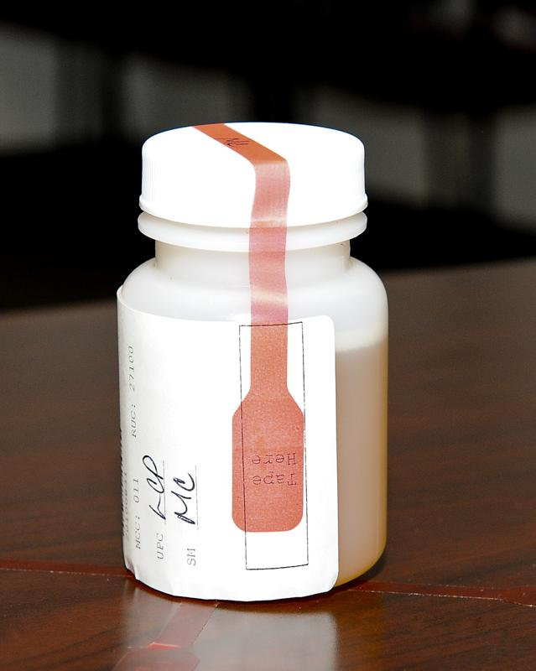
Marine Corps Policy on Urinalysis
MCO 5300.17 states:
ALL Marines are screened annually, regardless of rank, for the presence of drugs. Additionally, unit commanders will direct the SACO to test at least ten percent of their population monthly

Slide 18
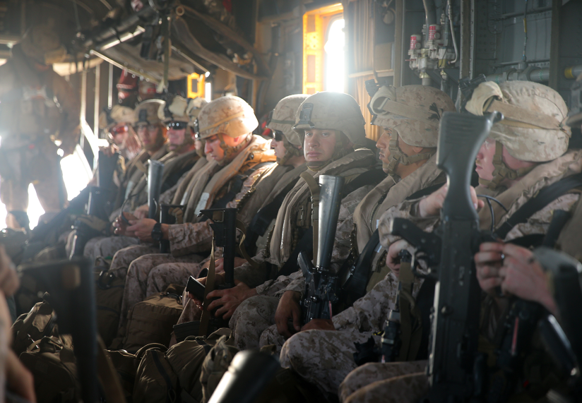
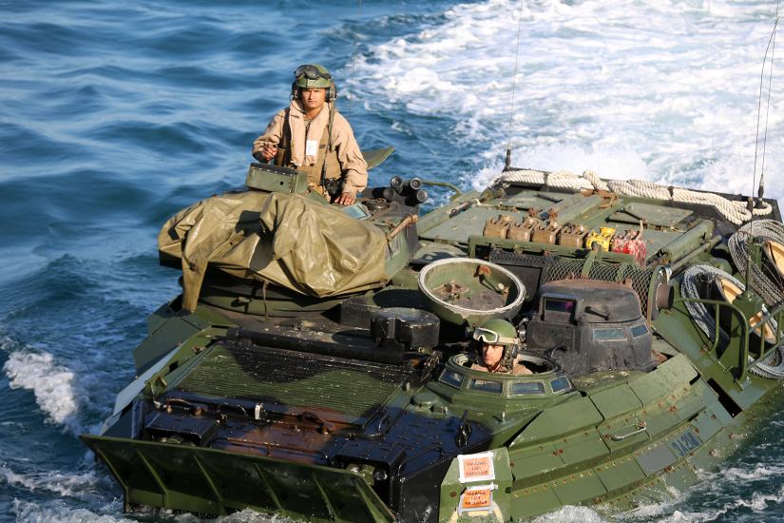
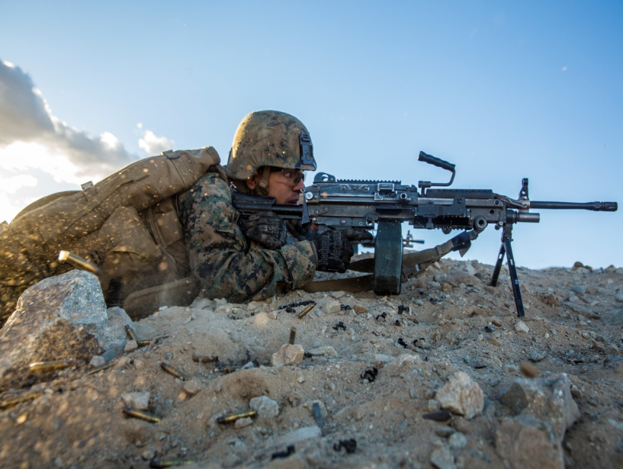
The Bottom Line
Substance Abuse hinders us from being America’s expeditionary force in readiness
High-risk drinking and using drugs impairs judgment and ability to deal with stress

