Slide 1
Commander’s Request Mast Program Updated January 2018
Inspector General of the Marine Corps

Slide 2
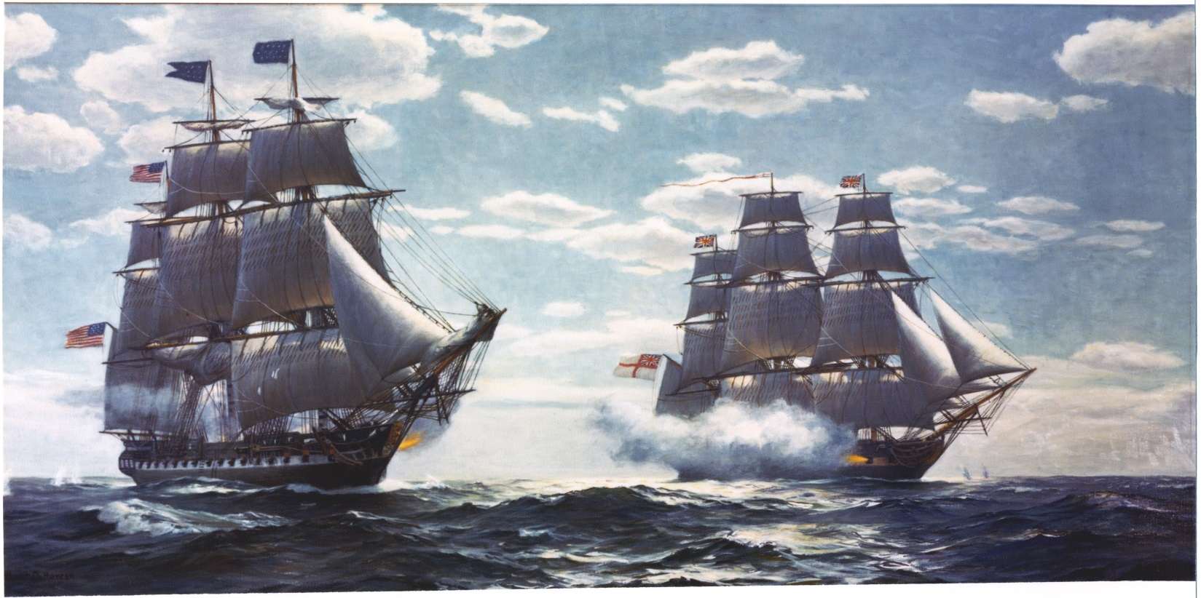
Mast Overview
History & purpose of Mast
Policy for Requesting Mast
Procedures for Requesting Mast
Most common findings/failures
2

Slide 3
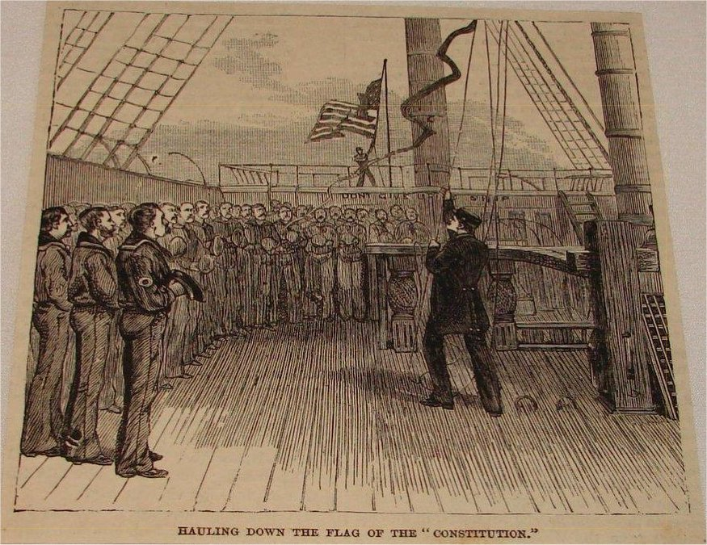
The History of Mast
Naval tradition
Commander’s interaction with ship’s crew
Dispense punishment
Present awards
Accept grievances
Ship’s crew had guaranteed right to speak to their Commander
Solutions were not assured
3

Slide 4
Purpose of Mast
Convey grievances directly to the Commander
Provides a personal audience with Commander*
Expedite processing of urgent concerns
Should employ the entire Chain of Command
Should not dismiss the “Chain of Concern”
Should not replace established staff functions
Should never supplant informal discourse
* Appearance with Commander should not present a conflict of interest or affect neutrality
4

Slide 5
Request Mast Policy
According to Marine Corps Order 1700.23F, it is "the right of all Marines to directly seek assistance from, or communicate grievances to, their commanding officers." A Marine has "the opportunity to communicate not only with his or her immediate commanding officer, but also with any superior officer in the chain of command up to and including the Marine's commanding general."
MCO 1700.23F
NAVMC 1700.23F (directive)
NAVMC 11296 (form)
Are there better avenues of redress?
Not appropriate for Mast:
Nuisance requests
Matters dealing w/ UCMJ or ADSEP
Contemplated, pending, in progress, or final
Administrative Actions
Performance Evaluation
5

Slide 6
The Chain of Command
Only Officers with NJP Authority
may be I&I, OIC, or Acting
Up to First General Officer
or designated O-6 with GCMCA
Commanders may be bypassed
only for cause, presented in writing
All Commanders must attempt to resolve grievances
Petitioner may withdraw request and accept resolution at any level
CG’s Eyes Only
must be explained in writing
usually facilitated by CIGs
Denials by designated Commander
submit denial reports via Chain to CG
In-person explanations not required
6

Slide 7
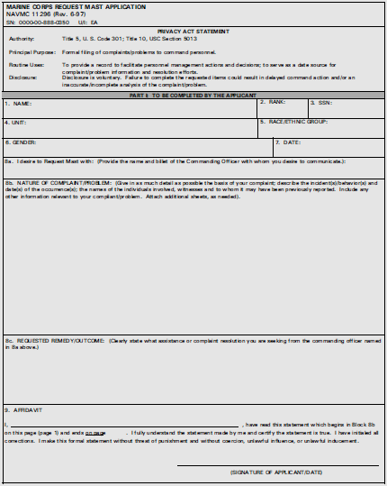
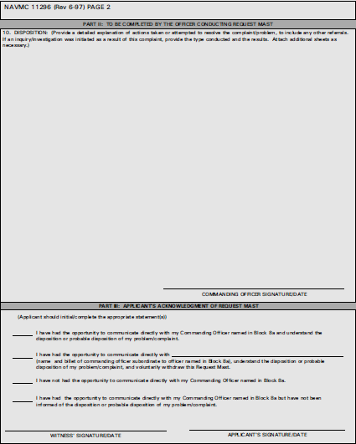
Request Mast Procedure
NAVMC 11296 (6-97)
Filled out, signed, & dated
Role of the Applicant
Be a truthful provider of facts
Cover letter if sealed request
Role of the “Chain of Concern”
Expedite request
Do not try to resolve
Role of the Chain of Command
Expedite audience with the Commander
Try to resolve at the lowest level of command
Explain disposition, delays, and denials
Forward-up if required
Report to CG any denials within one working week
If there is a denial, it must be explained to the Applicant
Personal explanations not required (especially if a conflict of interest exists)
7

Slide 8
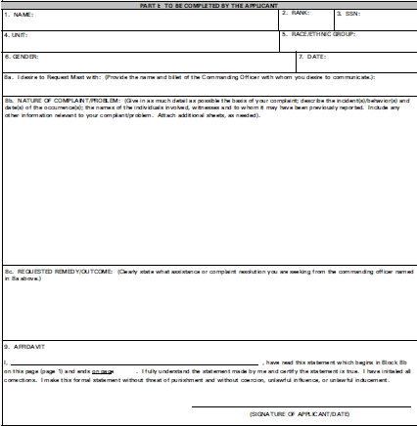
Request Mast Procedure
Personal, contact, and biographical data.
What Commander is requested?
What is the problem?
What is the desired “solution”?
Legal affidavit must be signed and dated. “Starts the Clock”
8

Slide 9
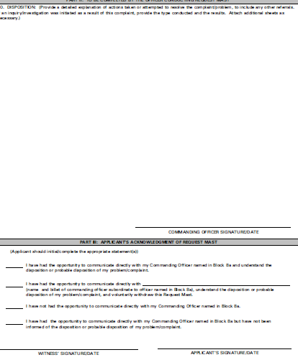
Request Mast Procedure
How did each Commander engage?
Final disposition; issue may not be resolved immediately
Final Commander to engage with Applicant. Sign & date, stops the clock
Applicant selects one acknowledgement.
Applicant and witness sign and date.
9

Slide 10
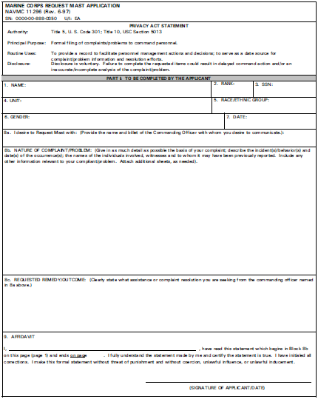
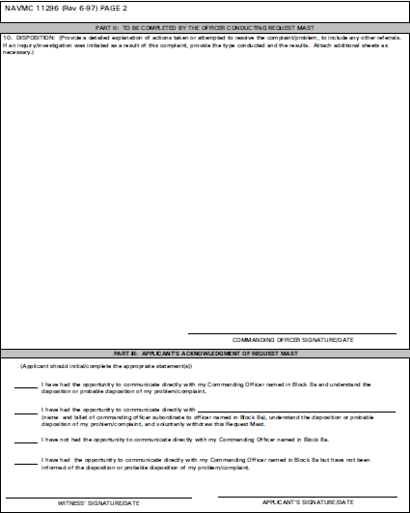
Request Mast Procedure
To uphold faith in the system, we get the Marine quickly before their Commander.
Actually resolving the issue correctly may take time, and must be tracked.
“Does the commander ensure all
Request Masts petitions are
expeditiously handled?”
10

Slide 11
Request Mast Procedure
If a subordinate commander, to the commander in block 8a, resolves the issue that subordinate commander is acknowledged in Part III and the Request for Mast is NOT forwarded any higher. ONLY Commanders can be acknowledged in Part III.
11

Slide 12
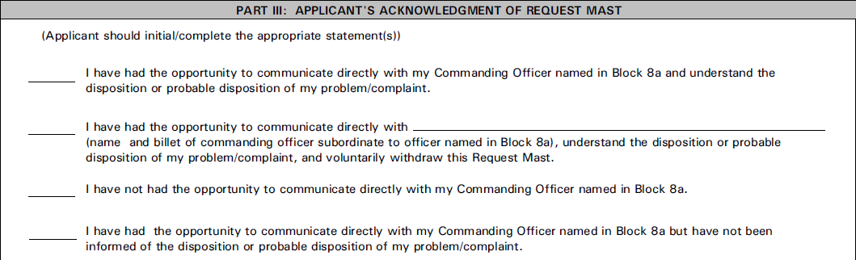
Request Mast Procedure
Used when the Marine has seen the Commander designated in 8a and understands the disposition of the complaint.
12

Slide 13
Request Mast Procedure
LtCol. Smedley D. Butler USMC
Used when a Marine sees a subordinate commander and understands the disposition and voluntarily withdraws sending the Request for Mast up to the commander originally designed in block 8a. This can never be used in a sealed “eyes only” request.
13

Slide 14
Request Mast Procedure
Used when a Commander refuses to directly communicate with an applicant. This is not the same as a denial.
14

Slide 15
Request Mast Procedure
Used when a Commander grants an audience with an applicant but does not inform the applicant of the disposition. This is not the same as a denial.
15

Slide 16
Legal Requirements
Commanders Must:
Hold accountable anyone who interferes with the Request Mast process
Hold accountable anyone who reprises against anyone who Requests Mast
16

Slide 17
Request Mast Follow-Up
Commanders must have a tracking system to ensure request are handled in an expeditious manner and to assure no adverse actions befall the Applicant for requesting Mast with the Commander.
17

Slide 18
Most Common Findings/Failures in Request Mast Programs
Commanders accepting inappropriate Requests for Mast that involve ADSEPs, Military Justice, bad FITREPs, etc.
“I still want to stay in the Marine Corps in spite of my involuntary separation…”
“Second-hand smoke caused my ‘pop’…”
“PMO should never have pulled me over…”
“I deserved a way better FITREP…”
Lack of tracking system for reprisals
Use a tracker; print out contact e-mails and keep them on file
Lack of evidence of any command training
Keep class rosters and class materials on file
Failure to destroy Request Mast applications on file after two-years
Failure to keep Request Mast files in a protected/locked file that only select individuals have access to
Inability to articulate the safeguards to protect Marines and Commanders from restriction and reprisal
18

Slide 19
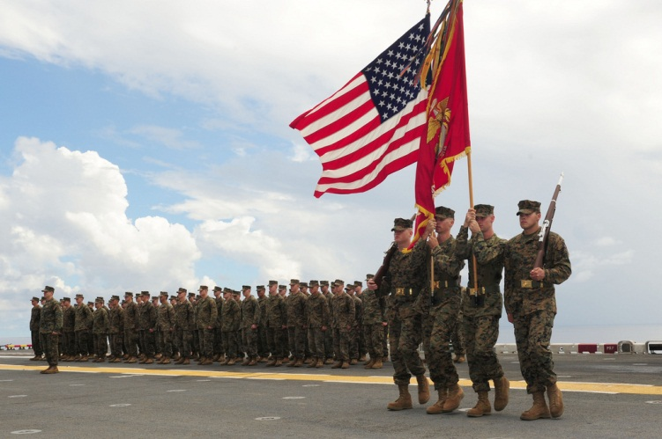
Questions
19
Notes:
a special place for us as Senior Leaders.

